Slide 1
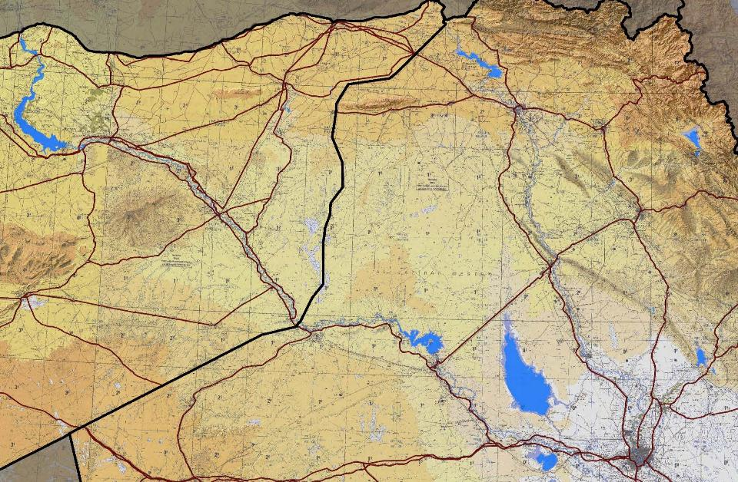
1
1
COALITION team building IN
OPERATION INHERENT RESOLVE

Slide 2
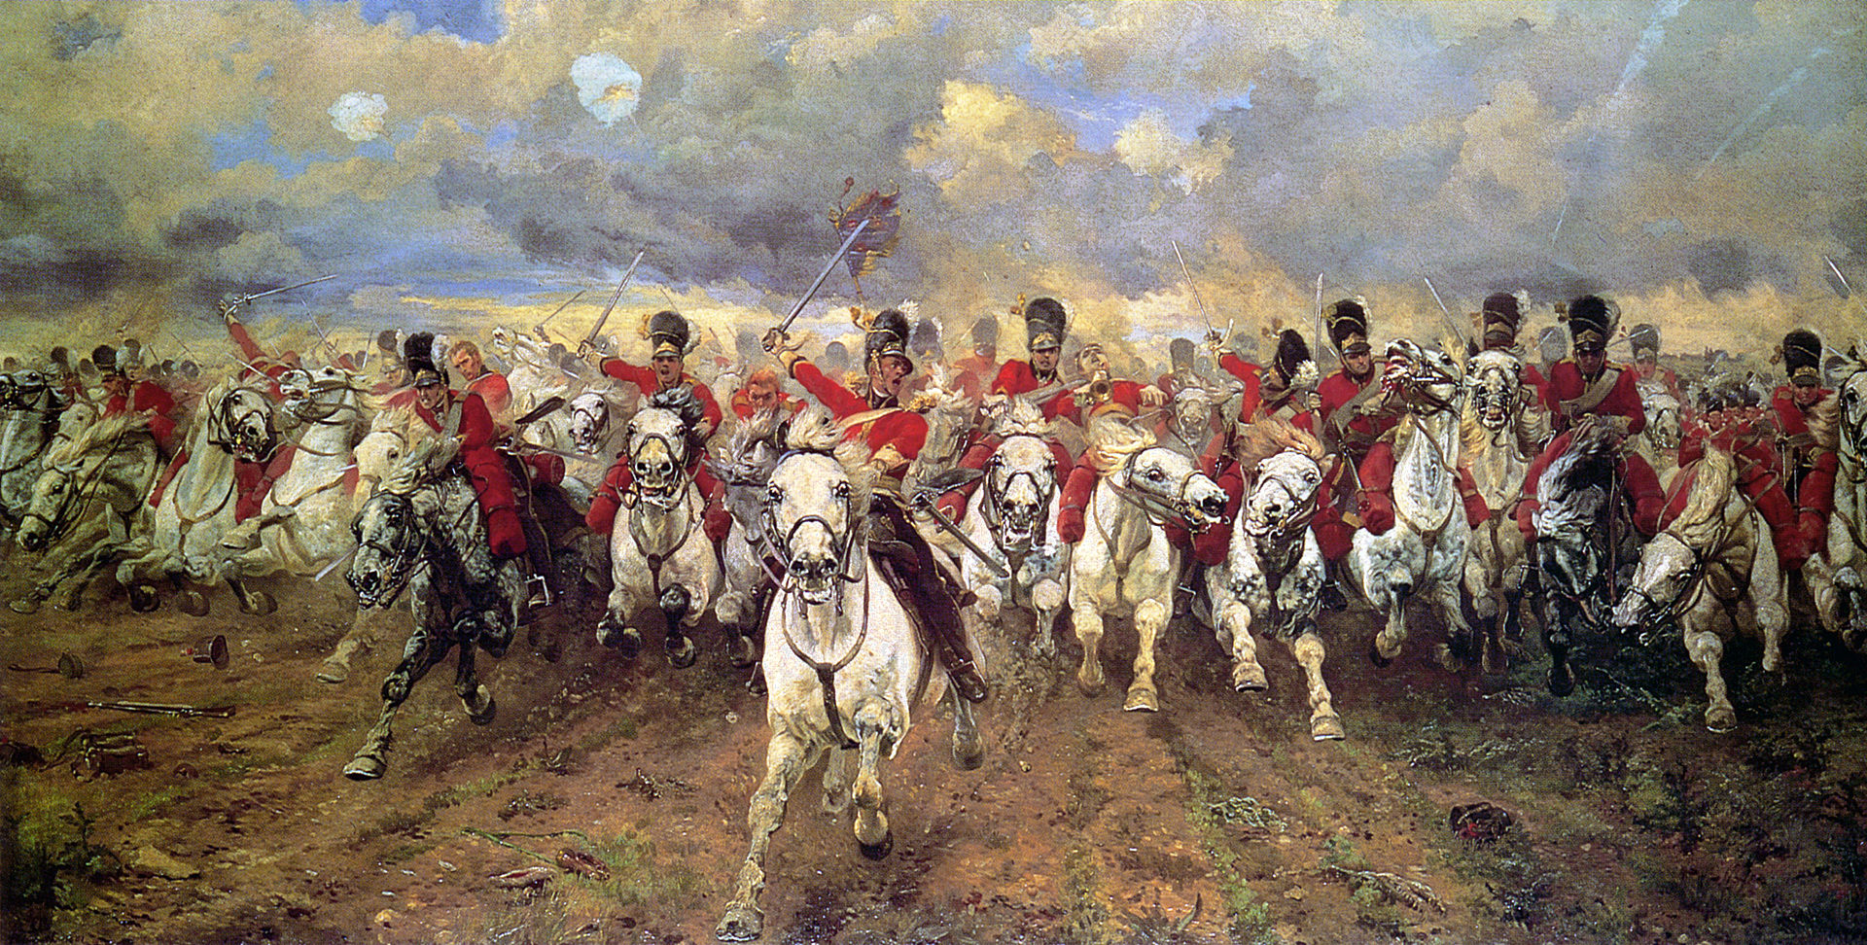
18 JUNE 1815

Slide 3
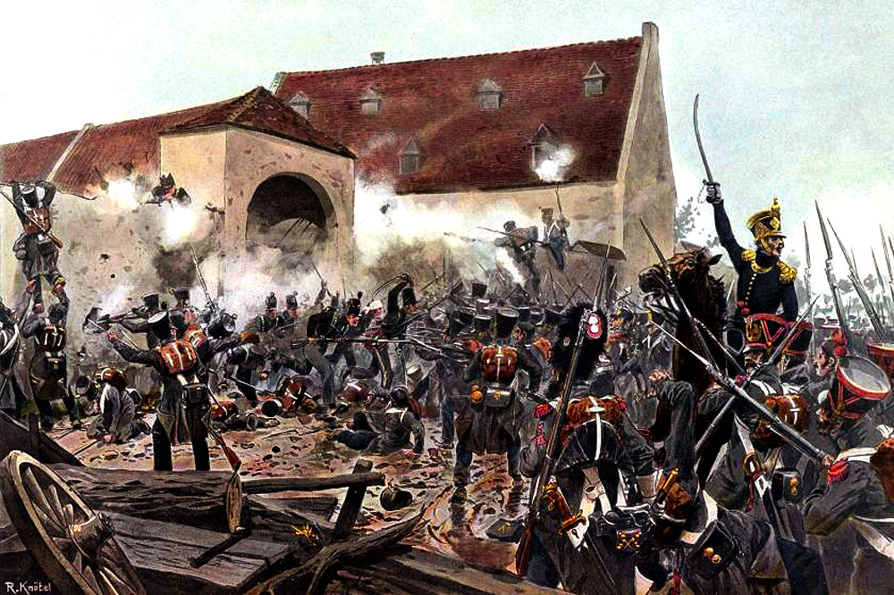
18 JUNE 1815

Slide 4
18 JUNE 1815
WATERLOO / MONT ST. JEAN

Slide 5
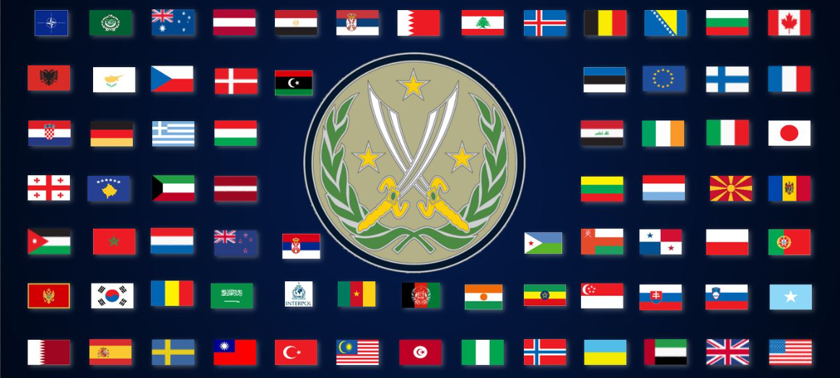
77 COUNTRIES & 4 INTERNATIONAL ORGANIZATIONS

Slide 6
ALLIED EXPEDITIONARY FORCE
“You will enter the continent of Europe and, in conjunction with the other United Nations, undertake operations aimed at the heart of Germany and the destruction of her armed forces.”

Slide 7
CJTF-OIR
“By, With, and Through our partner forces, Combined Joint Task Force - Operation Inherent Resolve (CJTF-OIR) defeats ISIS in designated areas of Iraq and Syria and sets conditions for follow-on operations to increase regional stability.”

Slide 8
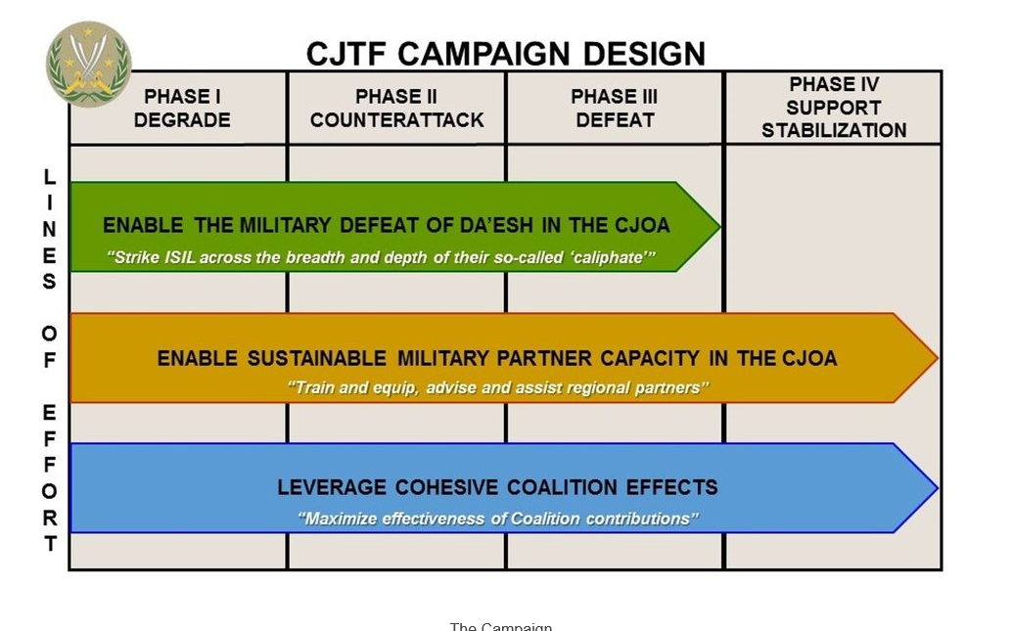
“In support of Line Of Effort 3, the CJTF will leverage the cohesive effects of the
contributions of the contributing nations of the Coalition. We accomplish this primarily by maximizing the effectiveness, or harnessing the power, of Coalition contributions of people, equipment, and logistics in support of our partnered forces.”

Slide 10
18 JUNE 1815
WATERLOO / MONT ST. JEAN

Slide 11
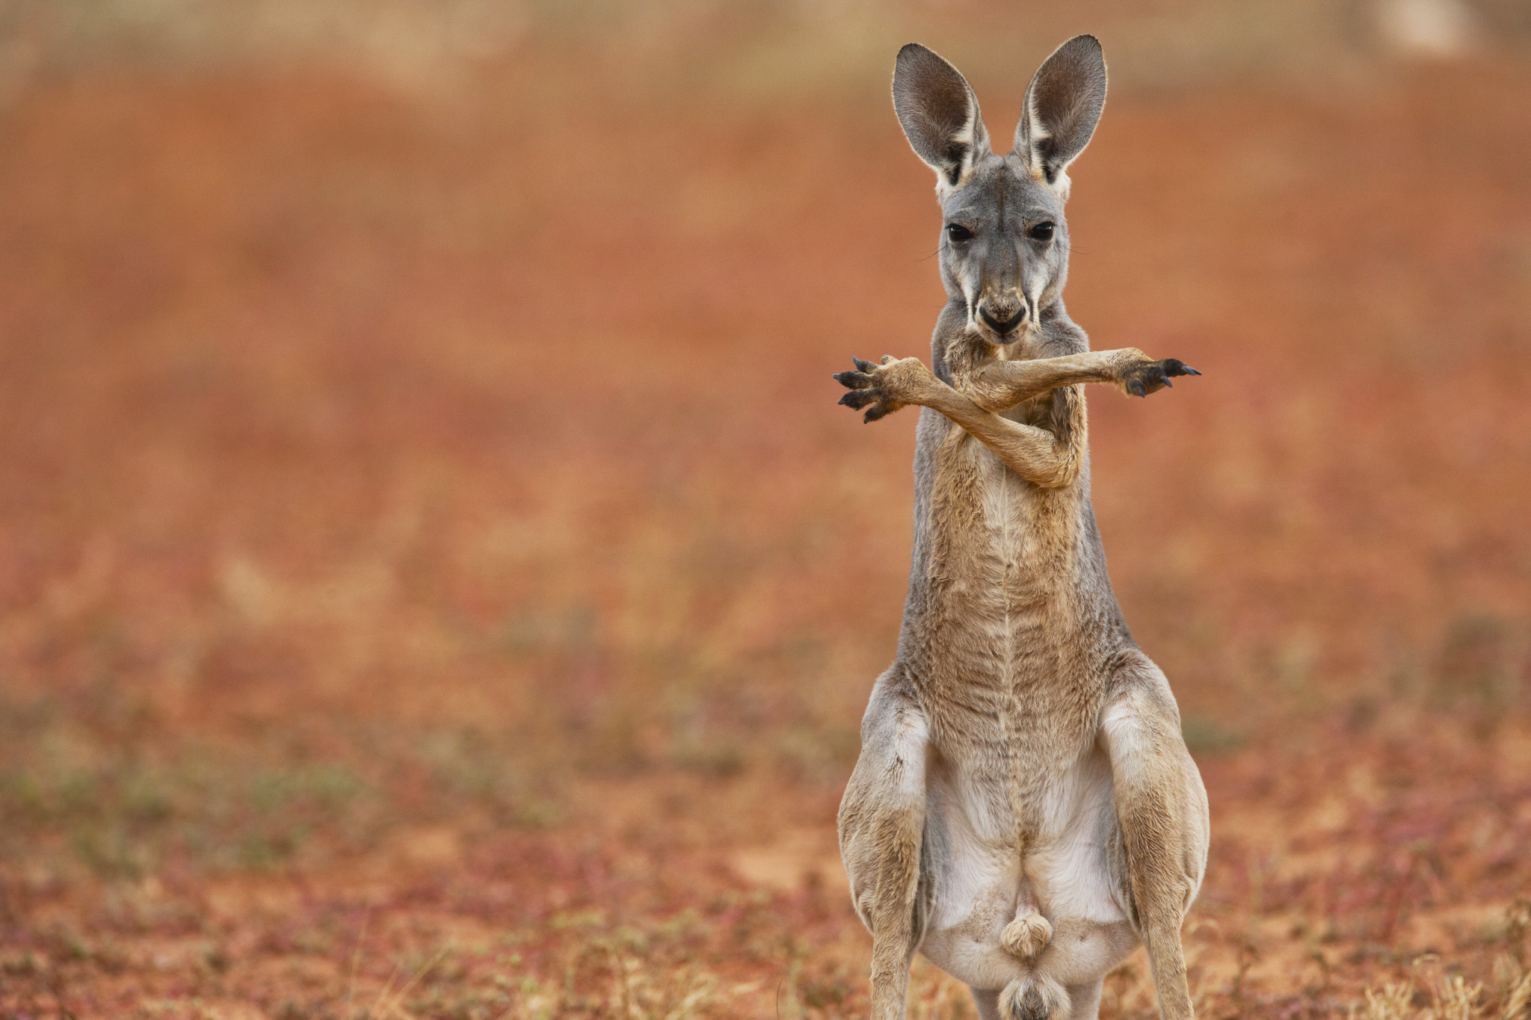

Slide 12
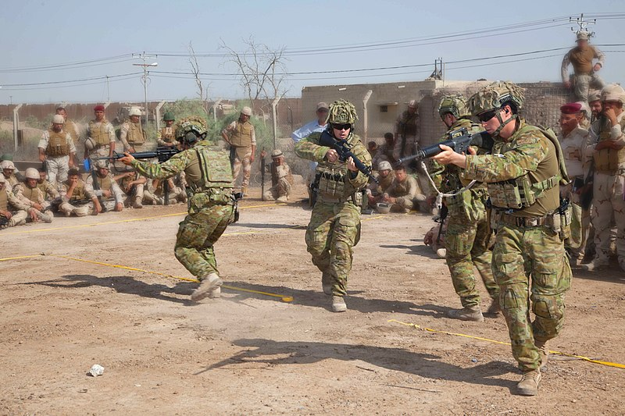
BPC – DEGRADE / C-A / DEFEAT

Slide 13
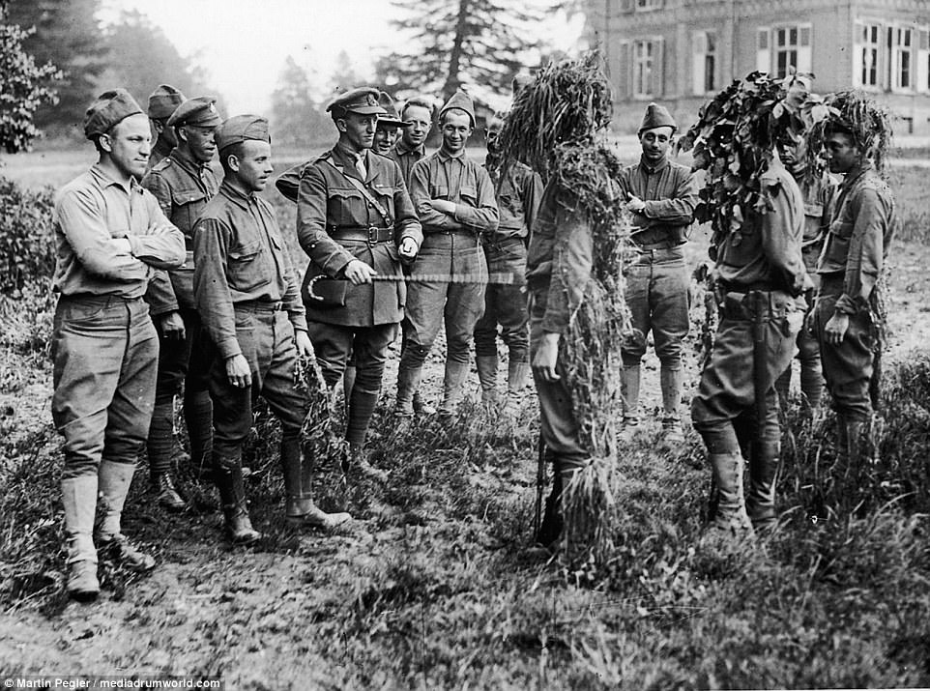
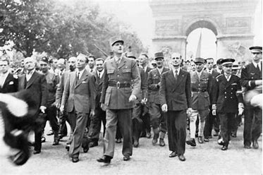
“There is only one thing worse than fighting with allies, and that is fighting without them.”
Winston Churchill
1 APR 1945

Slide 14
1
1
COALITION team building IN
OPERATION INHERENT RESOLVE

